Slide 1

DSLab
The Data Science Lab
Stream Processing 2
Spring 2020 – week #10

Slide 2
Stream Processing Module
Objectives
Review concepts of stream processing
Experiment with typical tools for
Data ingestion and processing
Week 09
Concepts
Experiments
Week 10
Advanced topics
Event Time vs Processing Time
Operations on streaming data (joins)
Homework

Slide 3
Event Time vs Processing Time
Event Time
Processing Time
delay

Slide 4
Event Time vs Processing Time
1
4
5
2
3
6
Event Time
1, 2, 3, 4, 5, 6, …
1
5
2
6
4
3
Processing Time
2, 3, 1, 6, 5 , 4, …

Slide 5
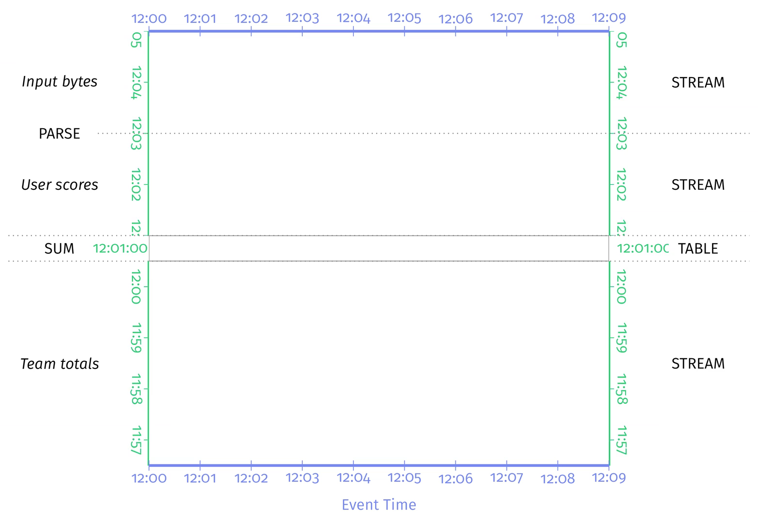
Event Time vs Processing Time
Credits: Tyler Akidau (et al.), Streaming Systems, O’Reilly Media, 2018.

Slide 6
Event Time vs Processing Time
Credits: Tyler Akidau (et al.), Streaming Systems, O’Reilly Media, 2018.

Slide 7
Event Time vs Processing Time
Credits: Tyler Akidau (et al.), Streaming Systems, O’Reilly Media, 2018.

Slide 8
Watermarking in Spark Streaming
Count on a sliding window of 10 minutes long with 5 minutes
sliding interval with 10 minutes watermarking (lateness).
from pyspark.sql.functions import *
windowedAvgDF = \ eventsDF \ .withWatermark("eventTime", "10 minutes") \ .groupBy(window("eventTime", "10 minutes", "5 minutes")) \ .count()

Slide 9
Operations
How it works
DStream: continuous stream of data
Created from inputs (e.g. Kafka) or derived from other DStreams
Supports transformations like RDDs
(map, count, join, etc)
Image credits: https://spark.apache.org/docs/latest/streaming-programming-guide.html

Slide 10
Operations: Joins
A
B
Joins
Combining different sets of data (tables) to get a set of results based on some criteria
Streaming Streaming
Stream-Static joins
Stream-Stream joins

Slide 11
Operations: Joins
Stream-Stream Joins:
2 streams over a common key
Example: Ad monetization (*)
(*) Databricks Engineering Blog, Introducing Stream-Stream Joins in Apache Spark 2.3 by Tathagata Das and Joseph Torres , https://bit.ly/2I58Ve7

Slide 12
Operations: Joins
Streaming Constraints (*)
Handling of late/out of order data
Boundaries
Solution
Use watermarks for delays / out of order impressionTime and clickTime
Set time range boundaries for the join conditions on event-time windows
(*) Databricks Engineering Blog, Introducing Stream-Stream Joins in Apache Spark 2.3 by Tathagata Das and Joseph Torres , https://bit.ly/2I58Ve7

Slide 13
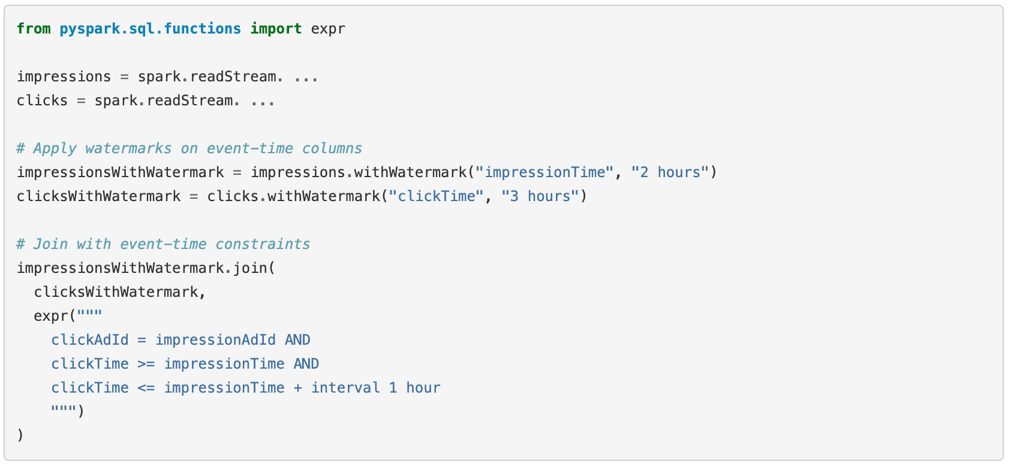
Operations: Joins

Slide 14

Homework
Historical data (Static)
Live data (streaming)
NS trains (Netherlands)

